Slide 1
Struct and Union in C
Shubham Dhungana

Slide 2
Struct
A structure is a collection of different variables under same name.
The variables are called member of the structure.
A structure can be defined as user defined data type, extending the number of available variables.
It can use other structures, arrays or pointers as its members.
A structure is convenient tool for handling a group of related data items.

Slide 3
syntax
struct structure_name{
dataType var1;
dataType var2;
dataType var3;
...
....
dataType varn;
}

Slide 4
Once the struct has been defined or declared then struct name acts as a new data type. Hence variables of that type can be declared as struct structure_name struct_variablenamae;

Slide 5
Example 1
Lets consider a structure of date:
struct date{
int day;
int month;
int year;}
Once the date struct is declared we can have:
date dateOfBirth; or
Date examdate,d1,d2,resultdate;

Slide 6
However we can have the structure definition and variable declaration in combine form as well.
struct date{
int day;
int month;
int year;}dateOfBirth,d1,d2,d3;
OR

Slide 7
struct {
int day;
int month;
int year;}dateOfBirth,d1,d2,d3;

Slide 8
Example 2
struct student
{
char name[20];
int roll;
float marks;
char remarks;
};
struct student s1,s2,s3;

Slide 9
How is it different from array:
Array contains related data of same type only, while structures can contain any data type of related variables.
A struct is user define data.
Struct name is not a pointer, whereas, array name is a pointer to the first element.

Slide 10
Structure initialization
Like standard data type, the structure variables of a structure can be initialized with some values.
struct student{
char name[20]; int role;float marks; };
struct student st={“harry”,10,88}; or
struct student st;
st.name=“harry”;
st.roll= 10;
st.marks= 88;

Slide 11
Array of struct example:
struct Employee{
char name[50];
int empId;
float salary;};
stuct Employee emp[5];

Slide 12
Initializing array of structures
For the above struct Array:
stuct Employee emp[5]=
{
“harry”,123, 5000,
“garry”,111,10000,
“Perry”,222,8000,
“Terry”,333,6000,
“Jerry”,444,5000};

Slide 13
Nested Structure
One structure may be nested within another structure’s definition.
For example:
struct date{
int day;
int month;
int year;}

Slide 14
struct person{
char name[50];
Int id;
struct date dob;
float salary;}p;
Here student person contains another struct date, which has 3 members. Now if we want to access the date-
p. dob.day, p. dob.month, p. dob.year,
p.name,p.id,p.salary

Slide 15
Pointer to structure
A pointer can also be used with a structure.
To store address of a structure variable, we can define a structure type pointer- variable in normal way:
struct date{
int day;
int month;
int year;}
struct date d;//d is a structure variable
struct date *p;//p is a pointer variable of structure type

Slide 16
Now the member of the structure can be accesed by the following:
d.day or p->day or (*p).day
d.month or p->month or (*p).month
d.year or p->year or (*p).year
dot (.) connects a structure with a member of the structure
Arrow(->) connects a pointer with the member of structure.

Slide 17
Union
Union is similar to structure with respect to a syntax and use.
The difference with structure is that all the members within a union share the same storage area of computer memory, whereas each member within a structure is assigned its own unique storage.
Thus the union is used to converse memory space.
Since same memory shared by all the members, only one variable can reside into memory at a time.

Slide 18
When another variable is to be stored into the memory, the pervious is replaced.
Hence union is not useful for application which requires multiple members where the values need to be assigned to all the members at the same time.
Although a union may contain many members of different types, it can only handle one member at a time.

Slide 19
#include <stdio.h>
#include <string.h>
union Data
{ int i; float f; char str[20]; };
int main( )
{ union Data data;
data.i = 10;
printf( "data.i : %d\n", data.i);
data.f = 220.5;
printf( "data.f : %f\n", data.f);
strcpy( data.str, "C Programming");
printf( "data.str : %s\n", data.str);
return 0; }

Slide 20
Enumerated data type
An enumerated data type is an user defined integer type consisting of set of named integer constant.
The keyword ‘enum’ is used to declare the enumerated data.
Syntax:
Enum enum_name{ identifiers1,identifiers2,identifiers3.......};

Slide 21
#include <stdio.h>
int main()
{
enum days{sun, mon, tue , wed, thrus , fri ,sat };
printf(“Lets see the value”);
printf(“Sunday =“,sun);
printf(“Monday =“, mon);
return 0;}

Slide 22
Node
Node consists of the data field and a pointer field.
// A linked list node
struct ListNode
{ int data;
ListNode *next;
};
No memory is allocated at this time
Like arrays, Linked List is a linear data structure. Unlike arrays, linked list elements are not stored at a contiguous location; the elements are linked using pointers.

Slide 23
Create a New Node
• Allocate memory for the new node:
newNode = new ListNode;
• Initialize the contents of the node:
newNode->value = num;
• Set the pointer field to NULL:
newNode->next = NULL;

Slide 24
Appending a Node
• Add a node to the end of the list
• Basic process:
– Create the new node (as already described)
– Add node to the end of the list:
• If list is empty, set head pointer to this node
• Else,
– traverse the list to the end
– set pointer of last node to point to new node

Slide 25
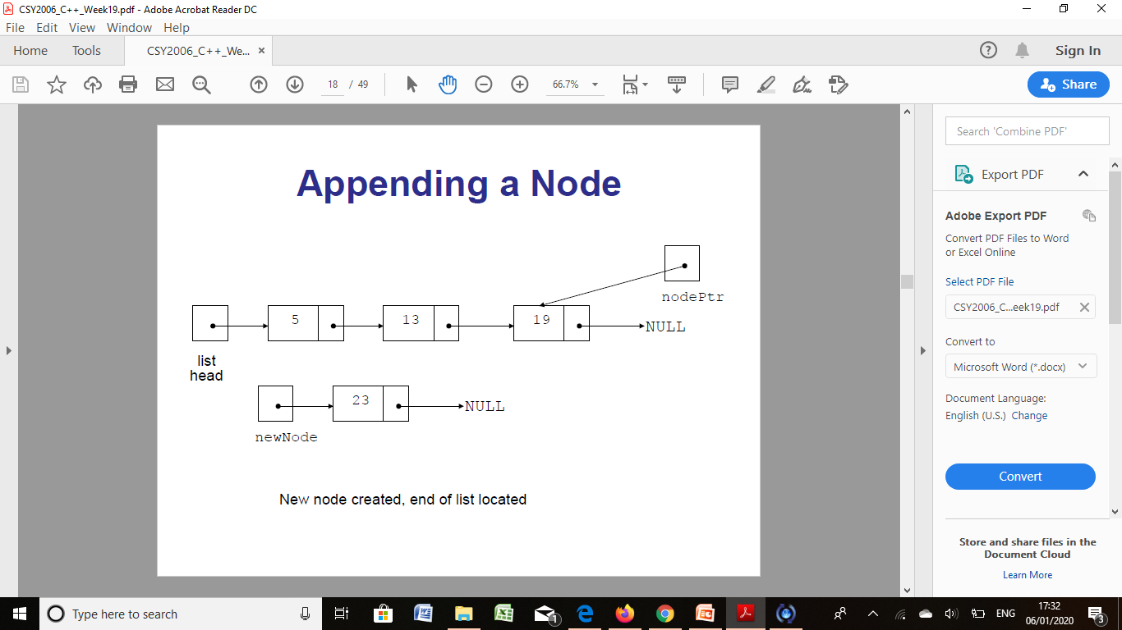

Slide 26


Slide 27
ListNode *newNode; // To point to a new node
ListNode *nodePtr; // To move through the list
// Allocate a new node and store num there.
newNode = new ListNode;
newNode->value = num;
newNode->next = NULL;
// If there are no nodes in the list
// make newNode the first node.
if (!head)

Slide 28
head = newNode;
else // Otherwise, insert newNode at end.
{
// Initialize nodePtr to head of list.
nodePtr = head;
// Find the last node in the list.
while (nodePtr->next)
nodePtr = nodePtr->next;
// Insert newNode as the last node.
nodePtr->next = newNode;
}
}

